Slide 1
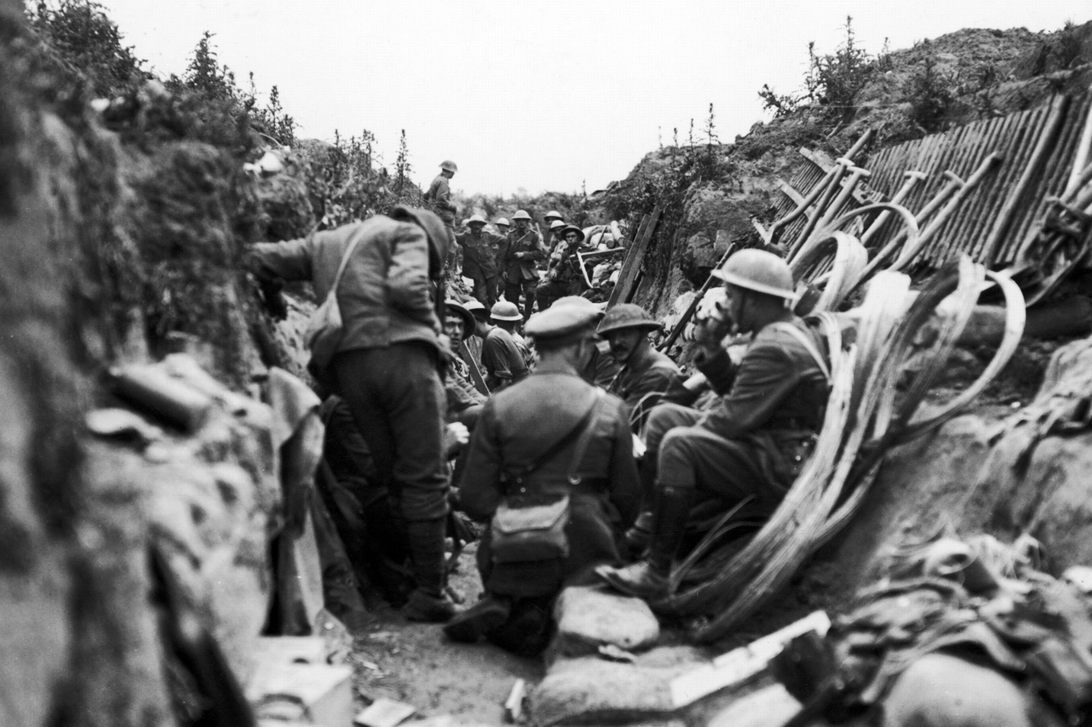
Sport during Christmas truce in WWI

Slide 2
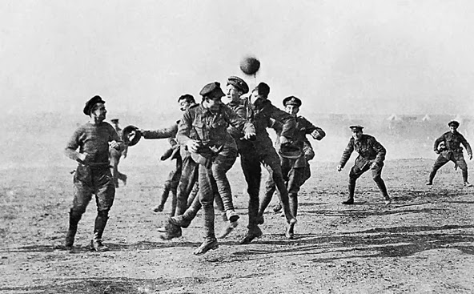


Slide 3
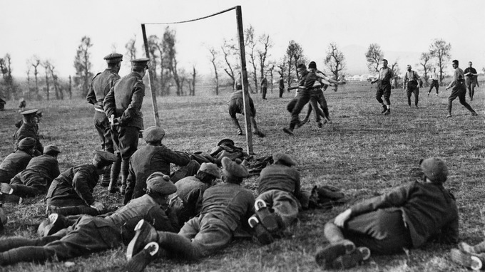

Slide 4
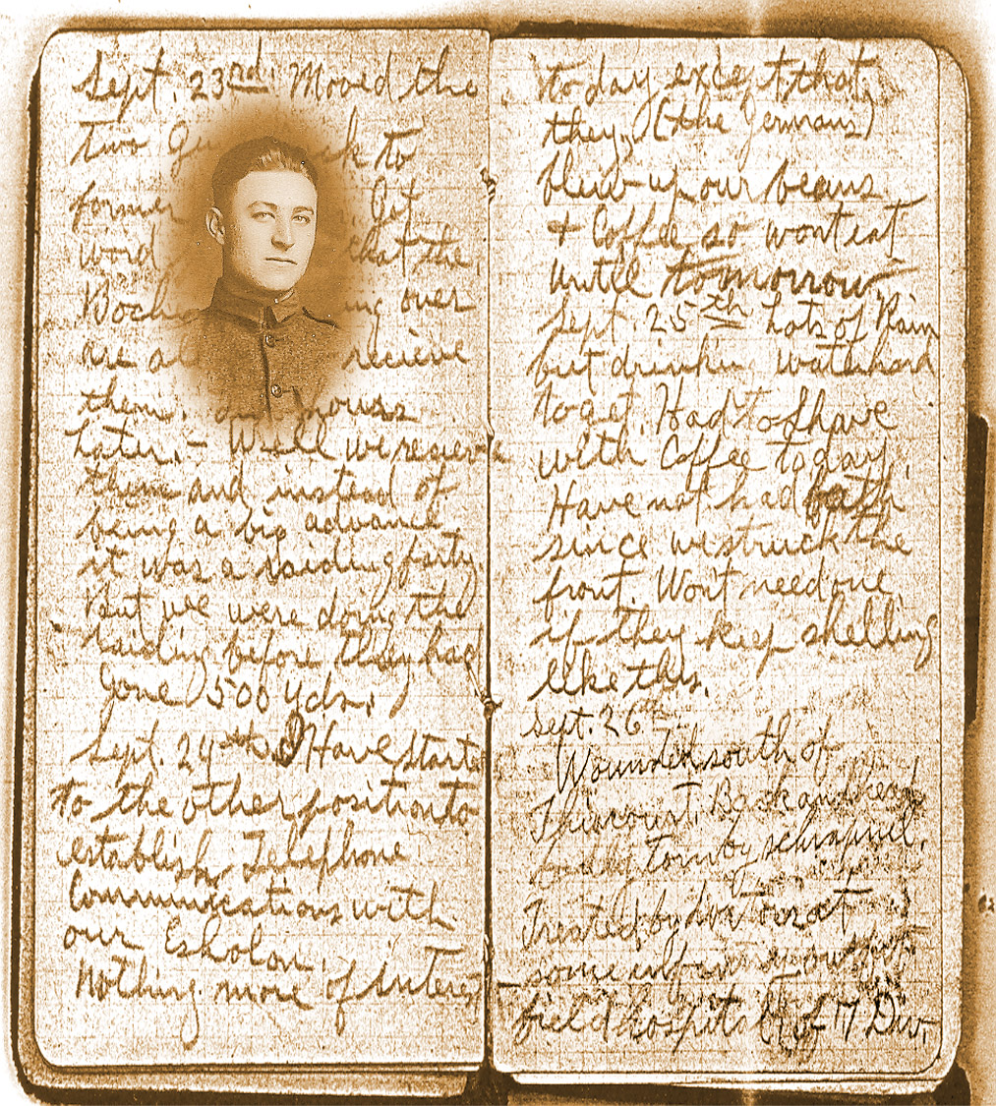

Slide 5
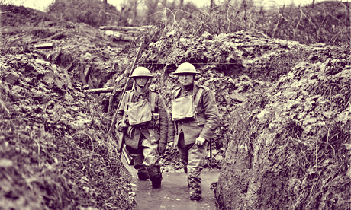

Slide 6
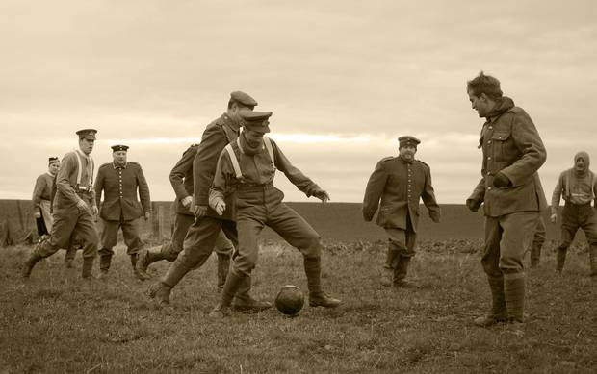

Slide 7
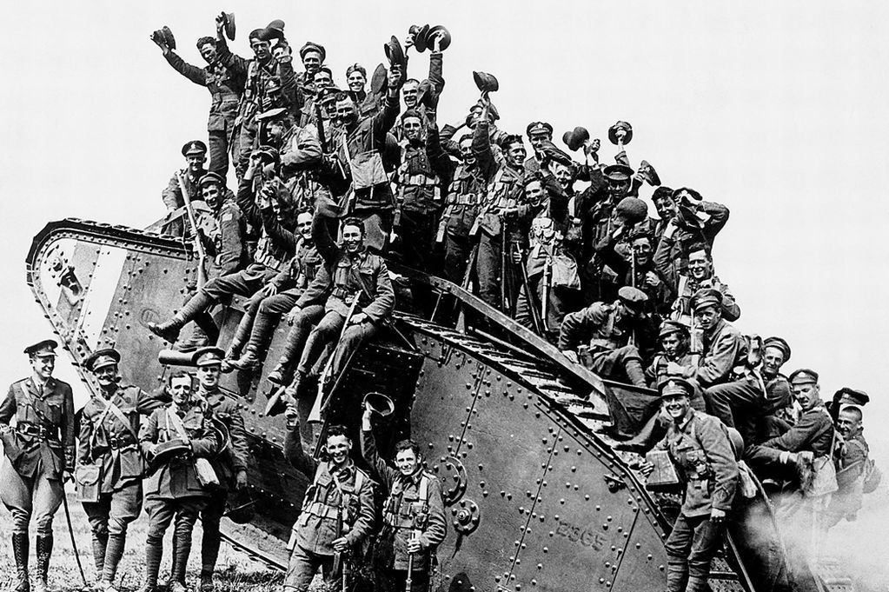

Slide 8
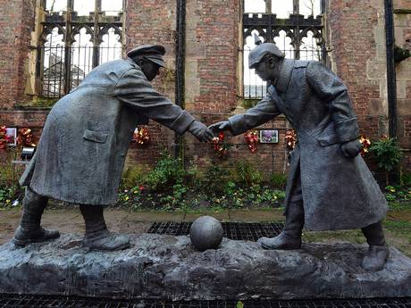
A resin model of a sculpture illustrating the Christmas truce football match, in Liverpool. The model will be cast in bronze once funds have been raised for its completion (Getty)

